Slide 1
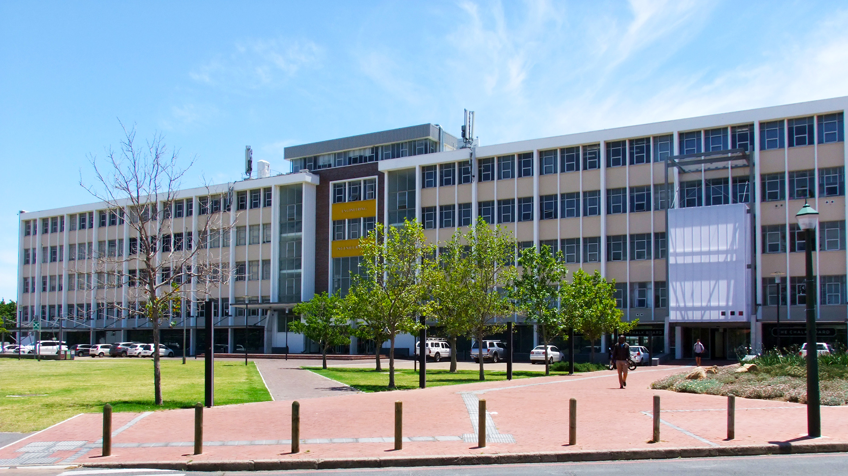
Weekly Meeting 20 Mei 2026 By Pieter Breytenbach
Photo by Stefan Els
Notes:
Picture placeholder slide layout
To change the picture:
Select the picture by clicking on it near the bottom of the slide (under the title placeholder), then click on the Picture Format tab.
Click on the Change Picture icon and choose the From a File/This Device… option.
Browse and select a picture and click on the Insert button.
Use the Crop command to adjust the image.
Click on the Crop command again to apply the changes.
Remember to add image attributions to photographs or artworks.

Slide 2
Last Week Meeting
Progress of the skripsie

Slide 3
This weeks progress
Hand-in the drawing pack
Received the new camera module
Programmed the code for the calibration and heat dissipation test
Wrote the safety report

Slide 4
This week’s planned progress
Perform safety test
Finish the heat transfer model of the report

Slide 5
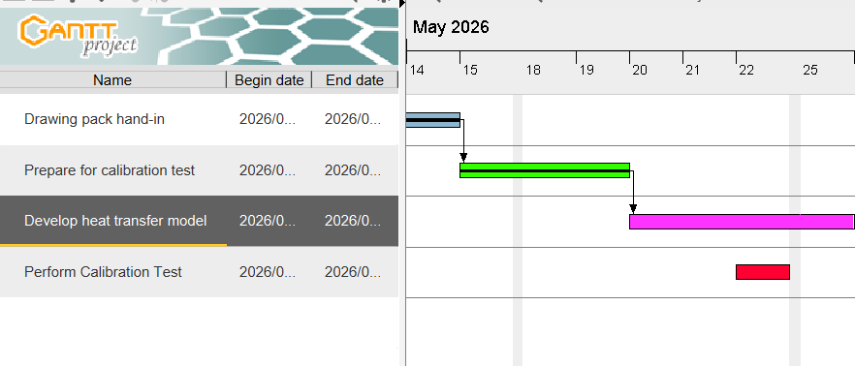
Gantt Chart

Slide 6
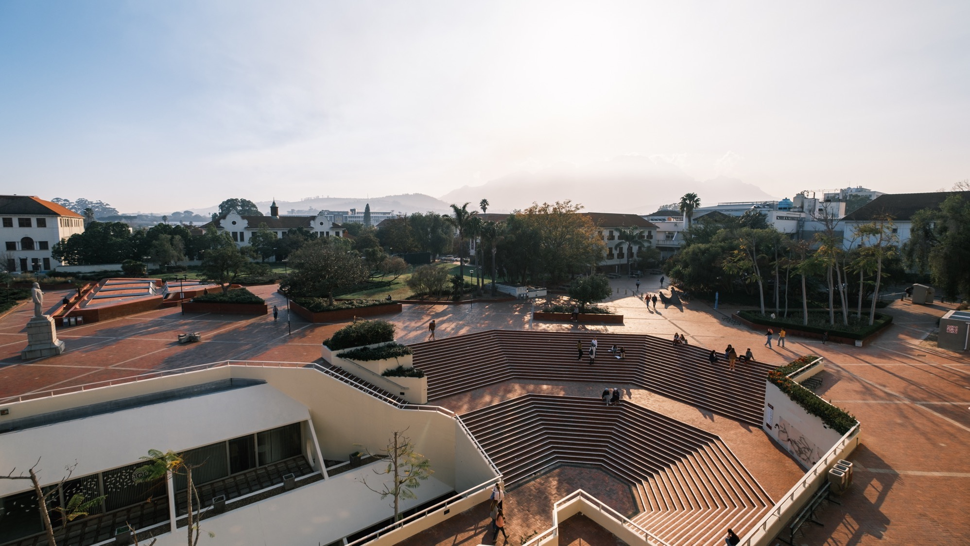
Thank you Enkosi Dankie
Photo by Stefan Els
Notes:
Cover/End slide layout
To change the picture:
Select the picture by clicking on it near the bottom of the slide (under the title placeholder), then click on the Picture Format tab.
Click on the Change Picture icon and choose the From a File/This Device… option.
Browse and select a picture and click on the Insert button.
Use the Crop command to adjust the image.
Click on the Crop command again to apply the changes.
Remember to add image attributions to photographs or artworks.

